Slide 1
Communicating with Data – Visualization Fundamentals Pt. 2
Dr. Ab Mosca (they/them)
Slides based off slides courtesy of Jordan Crouser (https://jcrouser.github.io/)

Slide 2
Plan for Today
Refresher: mental models
Putting marks together
Group activity: what we draw vs. what we see
Refresher: building blocks
Choosing visual channels
Group activity: does this follow the rules?

Slide 3
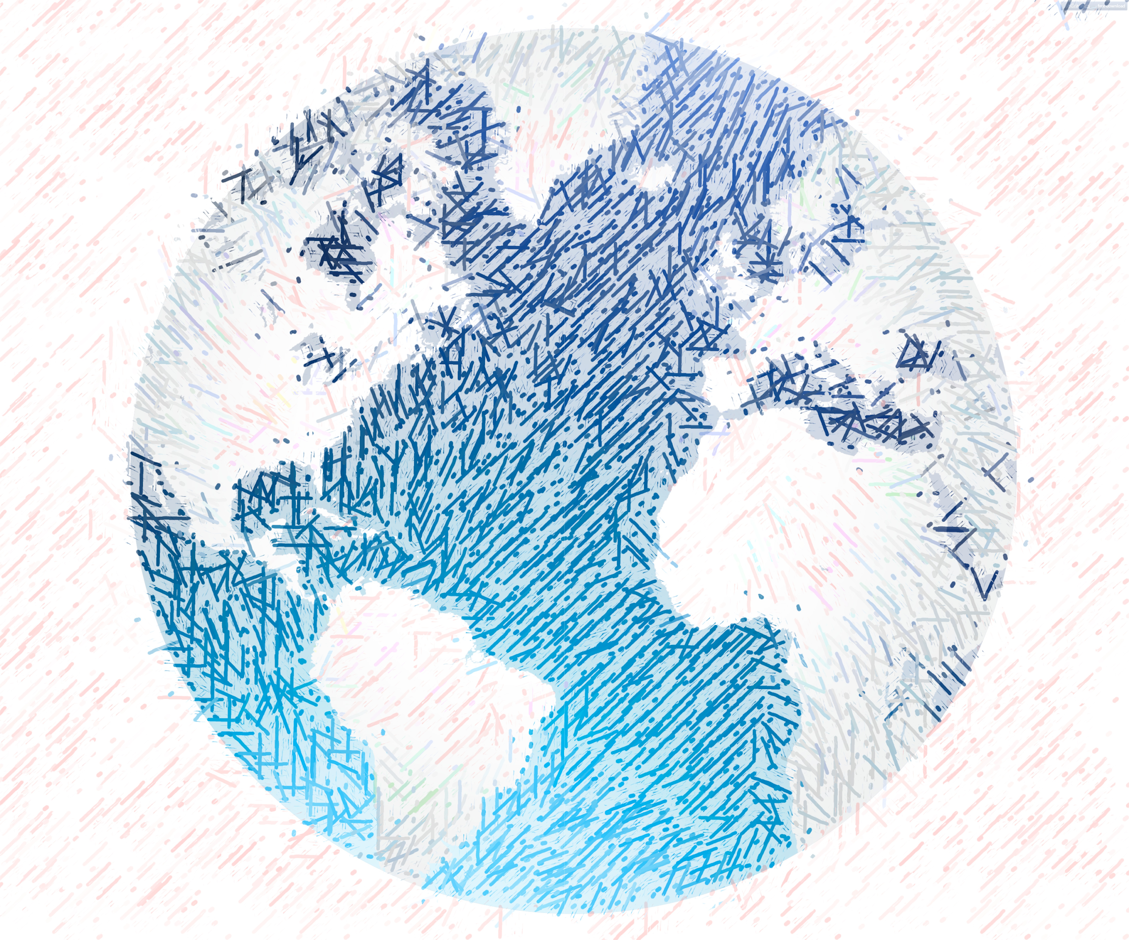


Mental Models

Slide 4
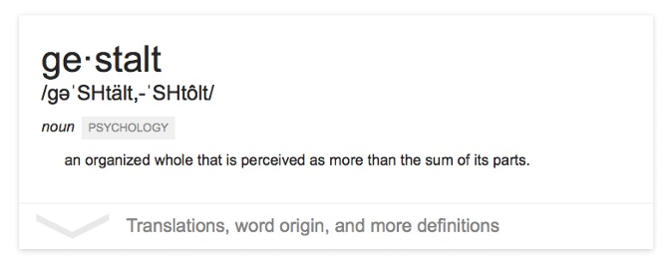
The “gestalt effect”
Our brain’s ability to generate whole forms, instead of just collections of unrelated elements

Slide 5



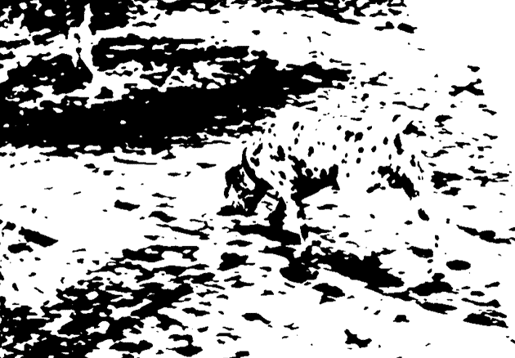
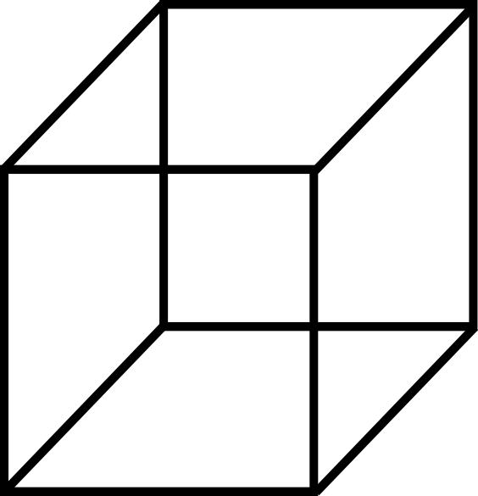
Emergence
Reification
Multistability
Invariance
Gestalt effects
Demonstration of reification in perception from Lehar S. (2003) The World In Your Head, Lawrence Erlbaum, Mahwah, NJ. p. 52, Fig. 3.3
Demonstration of invariance in perception from Lehar S. (2003) The World In Your Head, Lawrence Erlbaum, Mahwah, NJ. p. 53, Fig. 3.5
Life Magazine: 58;7 1965-02-19, p 120. Photographer: Ronald C James

Slide 6
What does this mean for visualization?
Question: what makes all this mental model stuff useful to us (designers and readers of data)?
Answer: in order to understand how people interpret and make sense of data, we need to know what cues they’re picking up on – and how to situate those cues within a larger framework
6 “Laws of Grouping”

Slide 7
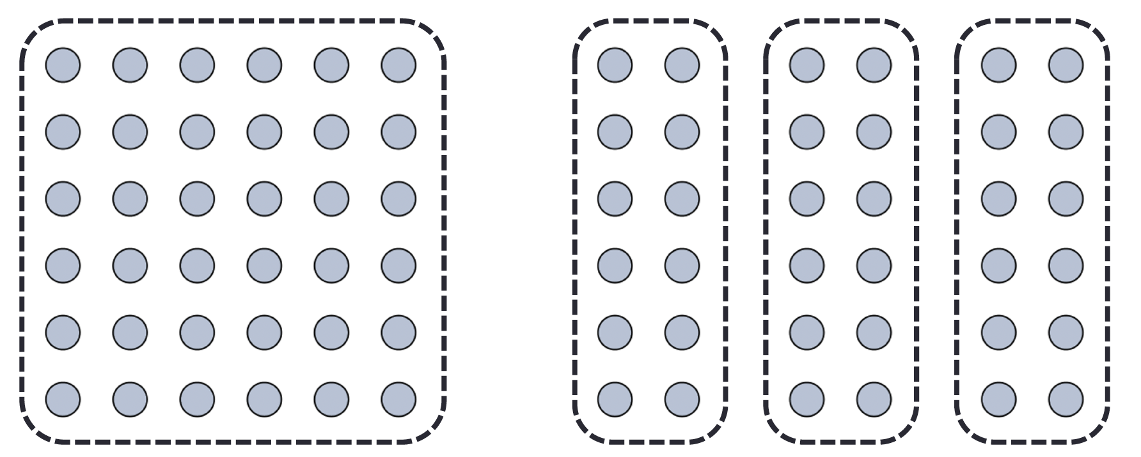
We interpret objects that are close to each other as a group
Law of Proximity

Slide 8
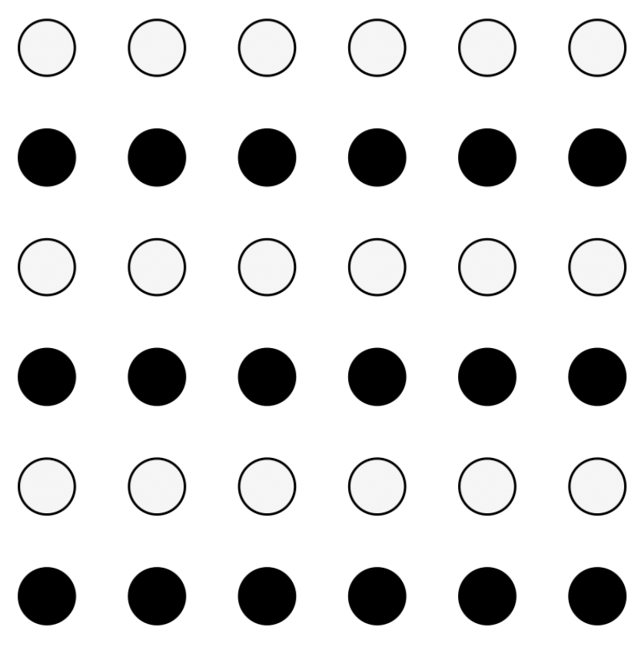
We interpret objects that are visually similar to each other as a group
Law of Similarity
“grey dots”
“black dots”

Slide 9

When parts of a picture are missing, we fill in the visual gap
Law of Closure

Slide 10
Law of Symmetry
We perceive objects as being symmetrical, arranged around a center point
law of proximity
[ ] { } [ ]
law of symmetry + law of similarity

Slide 11
We group objects that we perceive to be moving along the same path
Law of Common Fate

Slide 12
We tend to group objects along the smoothest path
Law of Continuity

Slide 13
Break into teams of 3
Choose a visualization from the Tableau Vis of the Day collection: https://public.tableau.com/app/discover/viz-of-the-day
Write the title on the board so we don’t get repeats!
Goal: identify as many examples of the Laws of Grouping (Gestalt Principles) in action in your sample visualization as you can
Be prepared to present your findings to the class
Let’s Practice

Slide 14

Group activity: what we draw vs. what we see
Let’s Practice
proximity
similarity
closure
[ ]
symmetry
common fate
continuity

Slide 15
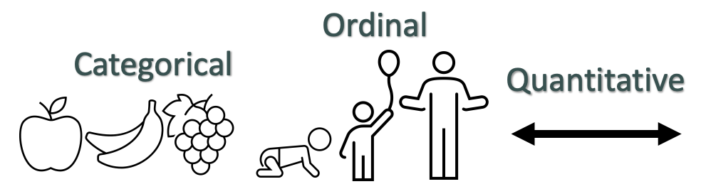
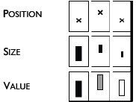

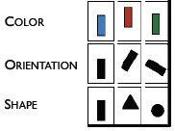
Data → Visuals
Remember… Big idea behind visualization
Map data dimensions to visual dimensions in a principled way
Not all visual dimensions can represent all data types
Jacques Bertin, Semiologie Graphique
(Semiology of Graphics), 1967.

Slide 16

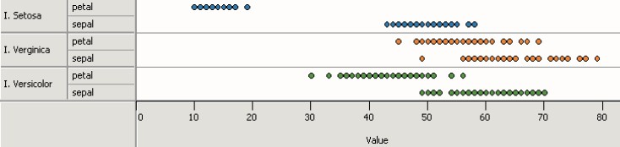



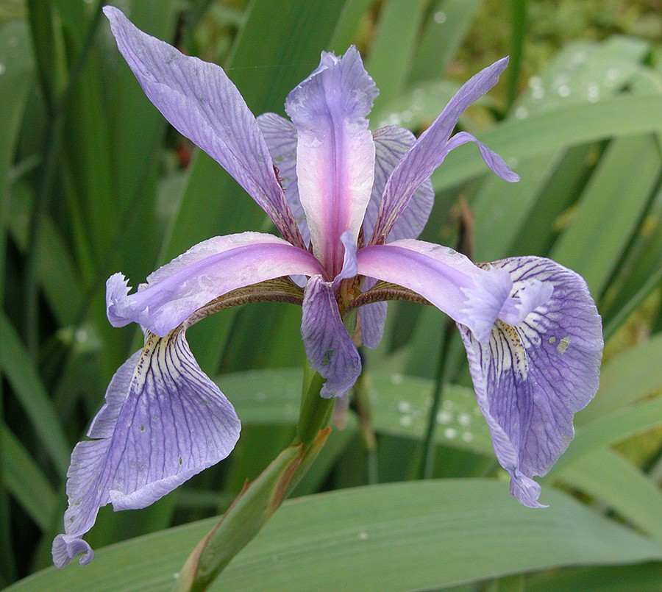

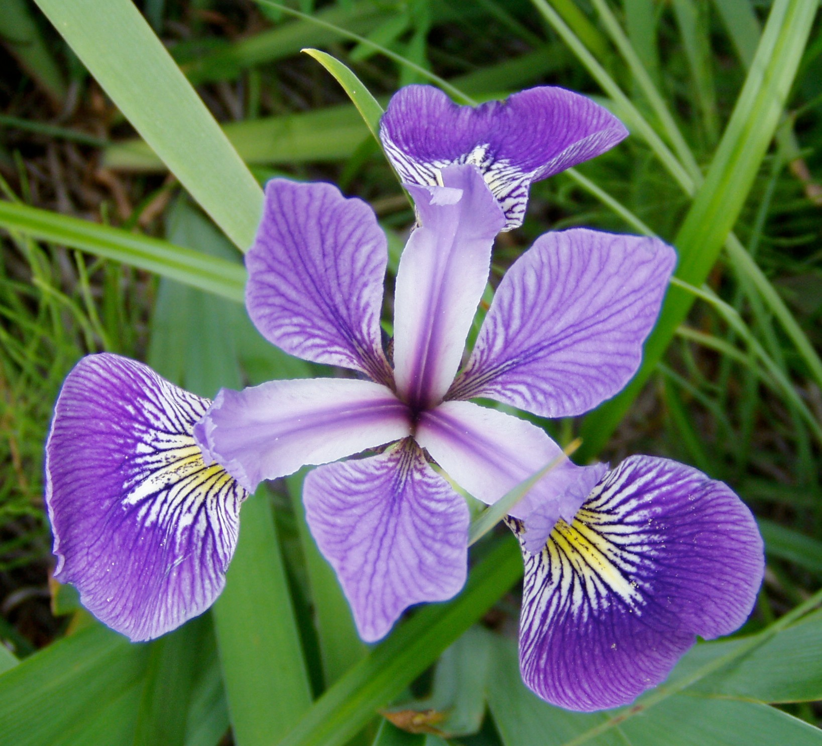

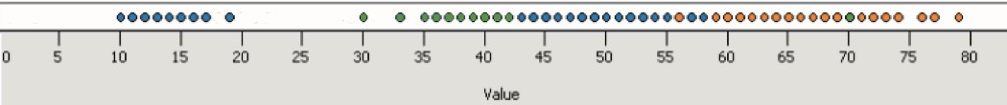
Principle 1: expressiveness
Encodes all the facts
Example:
Fig. Courtesy of M Krzywinski

Slide 17
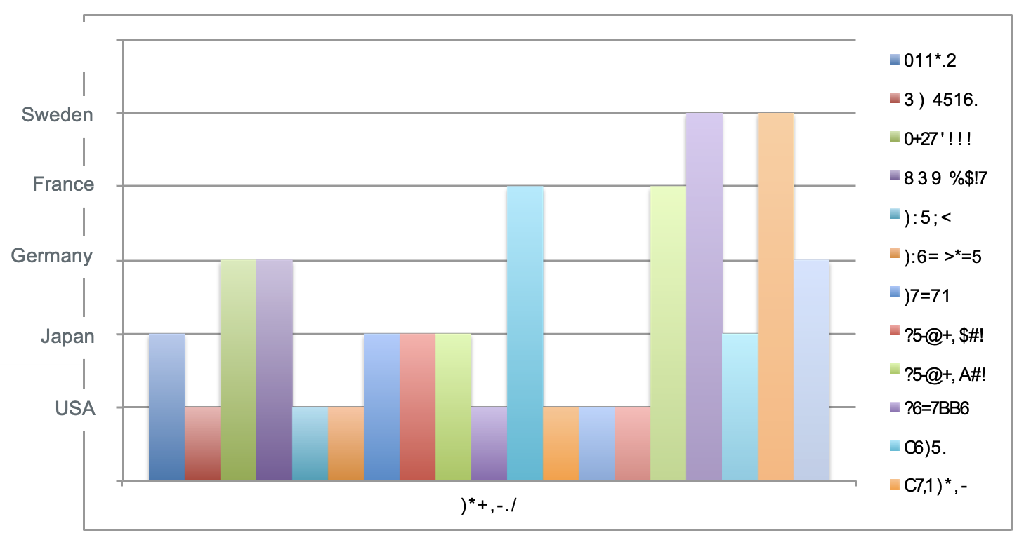
Encodes only the facts
(Bad) Example:
Principle 1: expressiveness
Adapted from Mackinlay J (1986) Automating the design of graphical presentations of relational information.

Slide 18
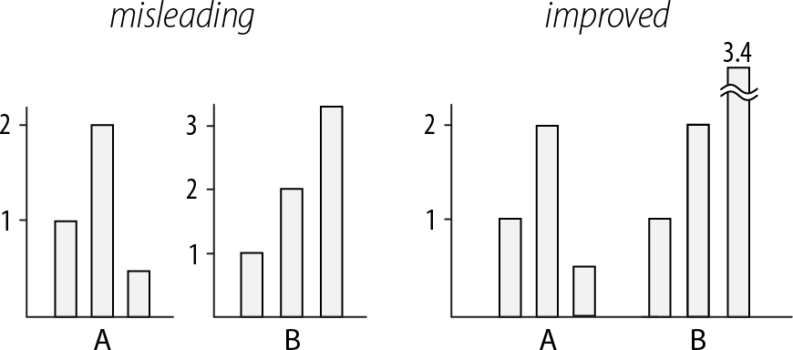
Use consistent axes when comparing charts
Principle 2: consistency
Raina SZ, et al. (2005) Evolution of base-substitution gradients in primate mitochondrial genomes. Genome Res 15: 665-673.
M. Krzwinski, behind every great visualization is a design
principle, 2012

Slide 19
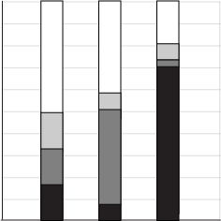
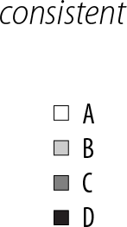
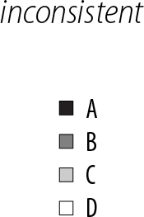
A note on legends: order items according to appearance
Principle 2: consistency
M. Krzwinski, behind every great visualization is a design principle, 2012

Slide 20
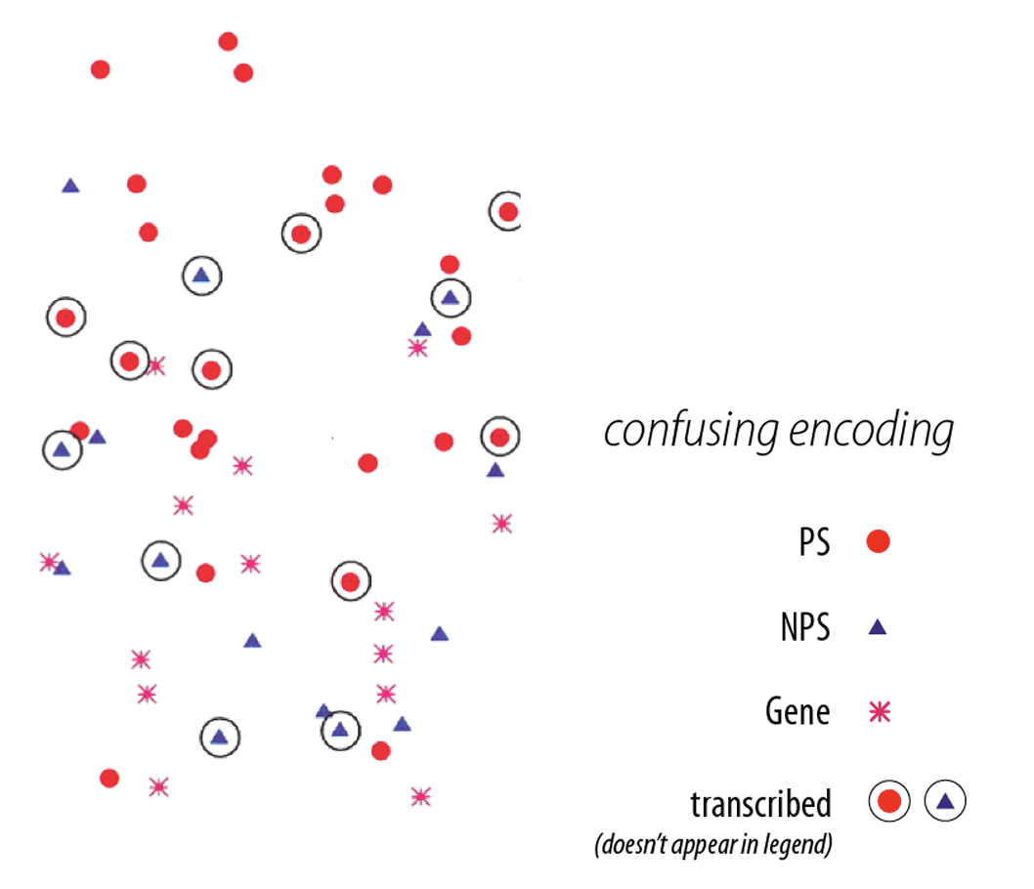
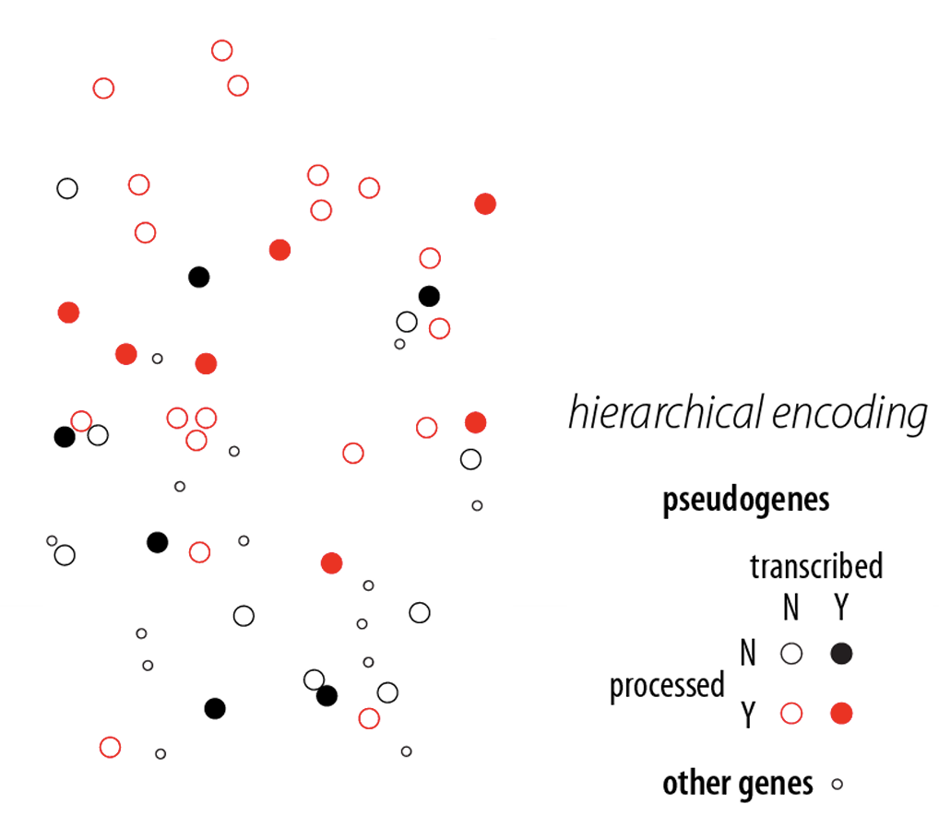
Visual variation should reflect and enhance the underlying variation in the data
Avoid visually similar encodings for independent variables
Example:
Principle 2: consistency
Fig. 2: M. Krzwinski, behind every great visualization is a design principle, 2012
Notes:
red - processed genes, but salience attenuated Ø ➢ other genes encoded with competing glyph - red star.

Slide 21
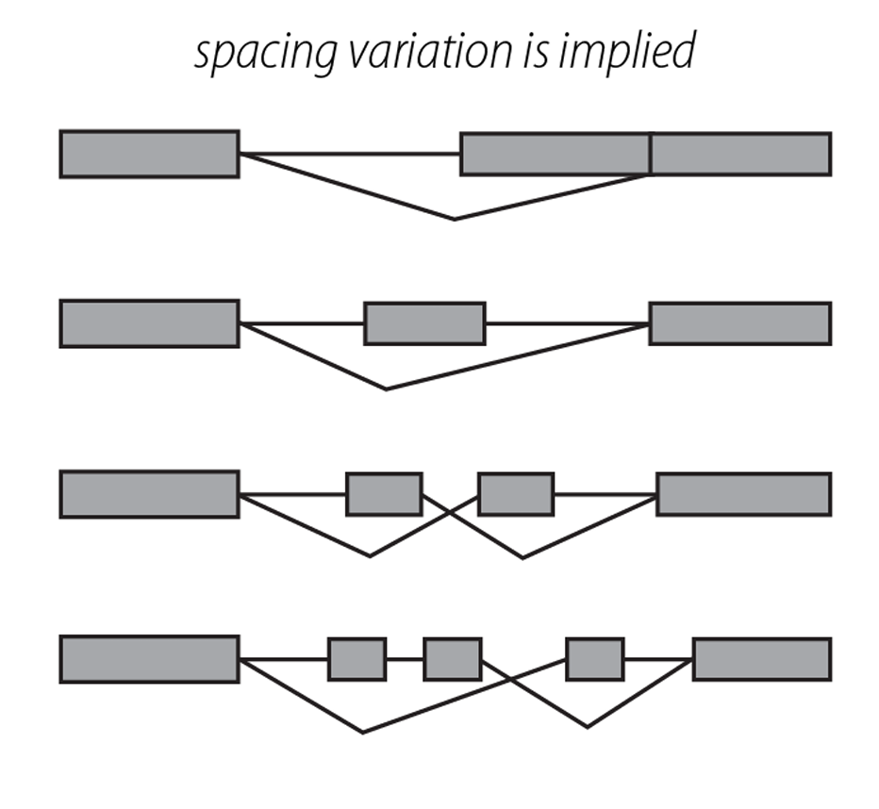
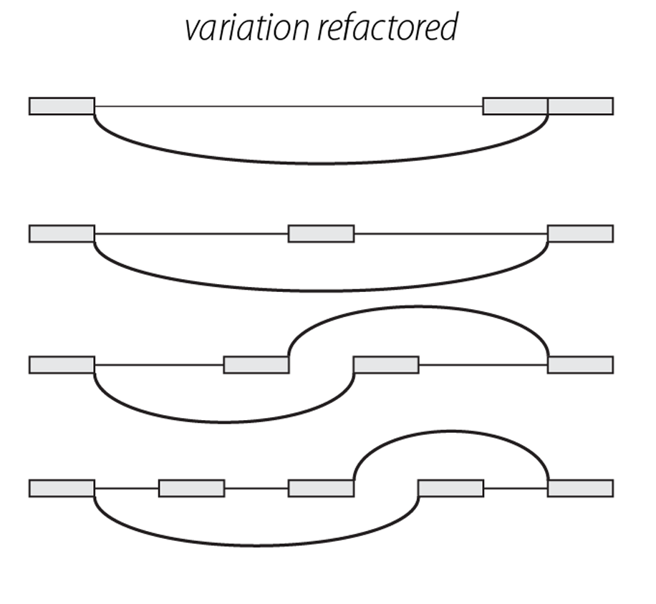
Uniform size and alignment reduces visual complexity and aids interpretation
Example:
Principle 2: consistency
Fig. 1: Sharov AA et al. (2005) Genome-wide assembly and analysis of alternative transcripts in mouse. Genome Res 15: 748-754.
Fig. 2: M. Krzwinski, behind every great visualization is a design principle, 2012

Slide 22

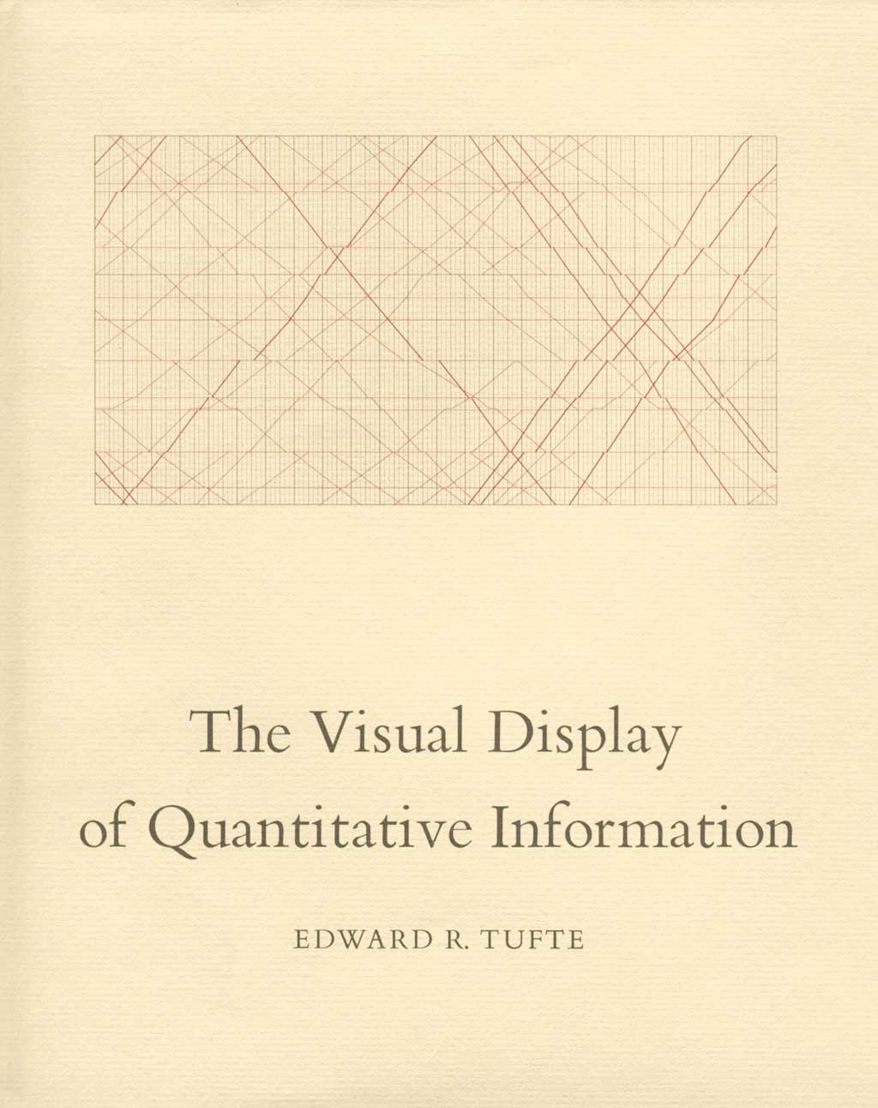
Tufte, 1983
“Above all else, show the data.”
Notes:
Kind of old news

Slide 23
Tufte, 1983
Data-ink
Data-ink ratio =
Total ink used to print the graphic
= proportion of a graphic's ink devoted to the non-redundant display of data-information
= 1 - proportion of a graphic that can be erased

Slide 24
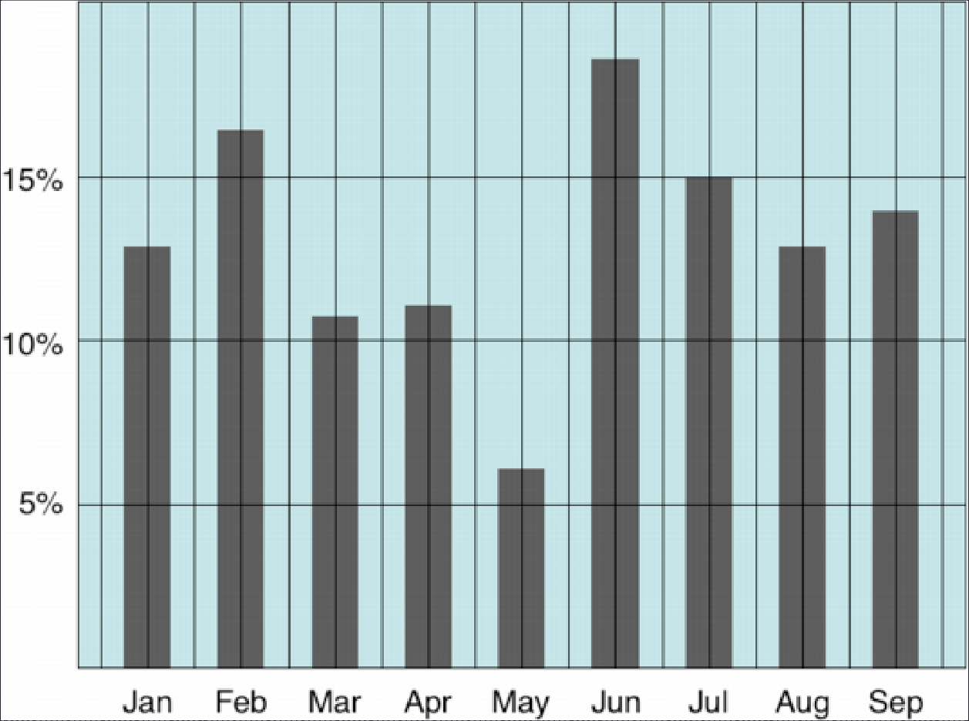
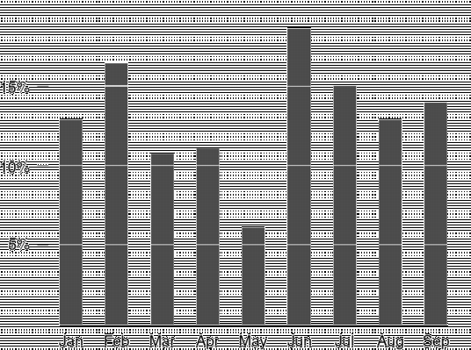

Tufte: maximize the data-ink ratio

Slide 25
Discussion
What do you think of the data-ink ratio?
Think of 3 specific ways to maximize it
Do you think there are limits or tradeoffs to this design approach?

Slide 26
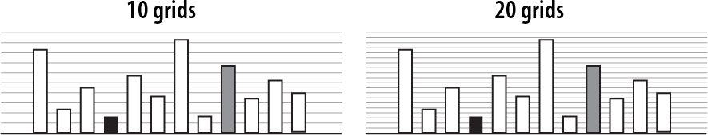
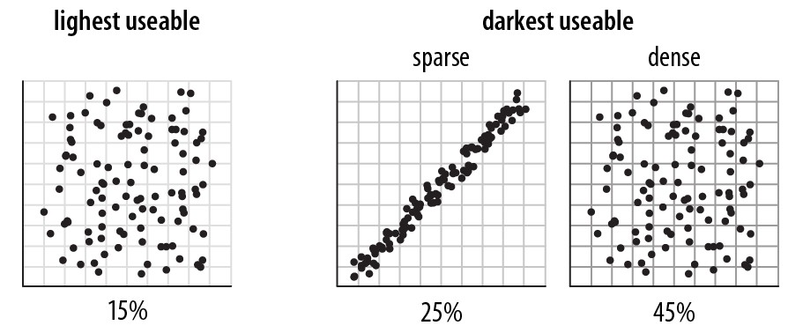
Navigational aids shouldn’t compete with data
Avoid: heavy axes, error bars and glyphs
Principle 3: importance ordering
Heer J, Bostock M (2010) Crowdsourcing graphical perception: using mechanical turk to assess visualization design. Proceedings of the 28th international conference on Human factors in computing systems. Atlanta, Georgia, USA: ACM. pp. 203-212.

Slide 27
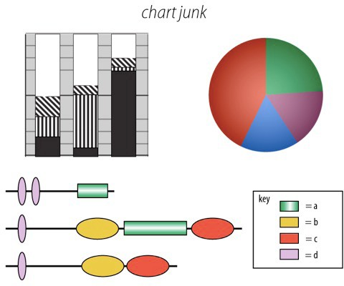
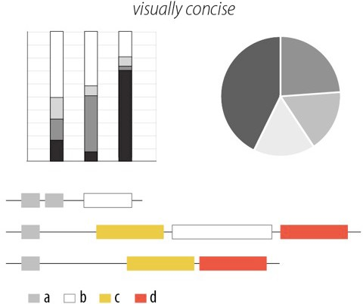
Simplify, simplify, simplify…
Principle 3: importance ordering
Sharov AA, et al (2006) Genome Res 16: 505-509.
Peterson J, et al. (2009) Genome Res 19: 2317-2323.
Thomson NR, et al. (2005) Genome Res 15: 629-640.
DB, Ko MS (2005) Genome Res 15: 748-754.
M. Krzwinski, behind every great visualization is a design
principle, 2012

Slide 28
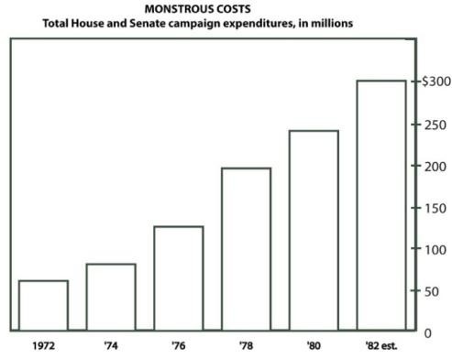
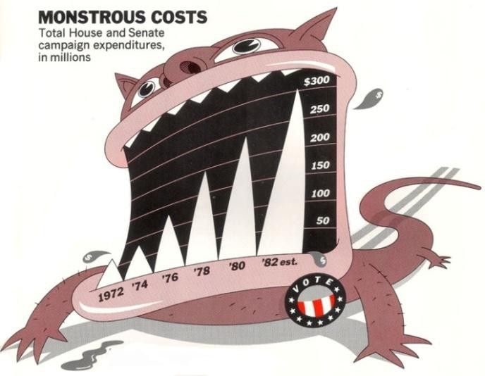

A caveat: “chart junk” and recall
Bateman et al. “Useful Junk? The Effects of Visual Embellishment on Comprehension and Memorability of Charts”, CHI 2010

Slide 29
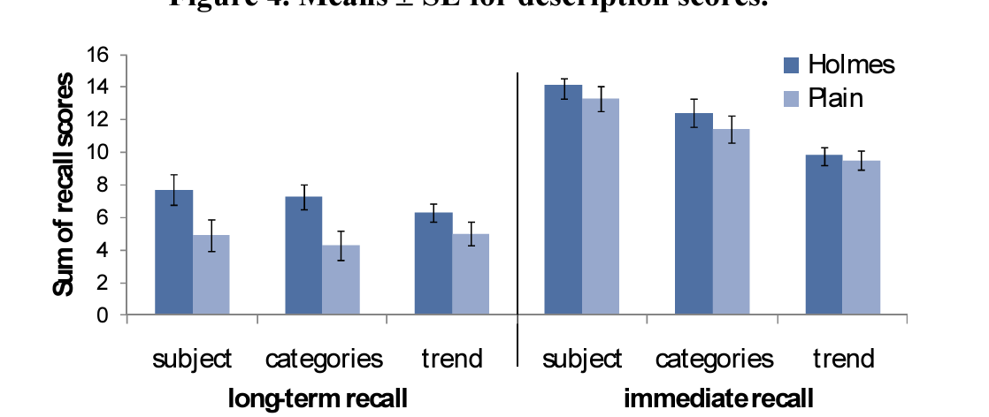
A caveat: “chart junk” and recall
Bateman et al. “Useful Junk? The Effects of Visual Embellishment on Comprehension and Memorability of Charts”, CHI 2010

Slide 30
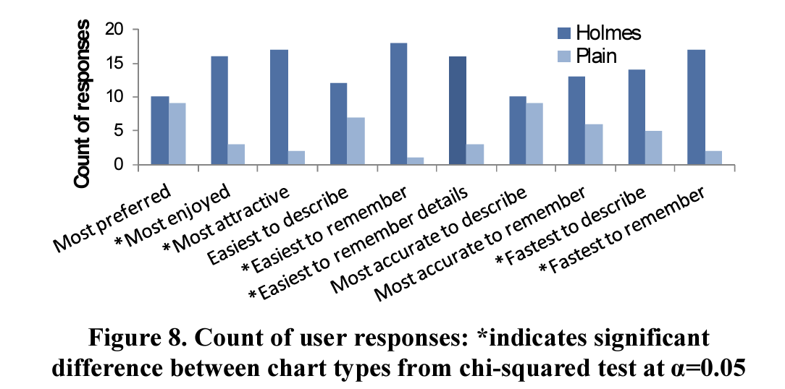
A caveat: “chart junk” and preference
Bateman et al. “Useful Junk? The Effects of Visual Embellishment on Comprehension and Memorability of Charts”, CHI 2010

Slide 31
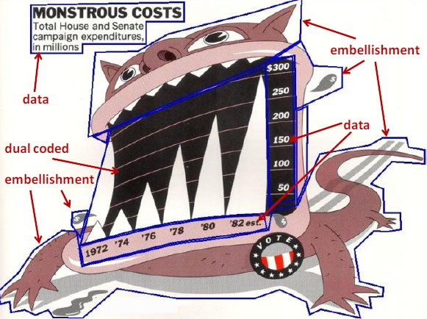
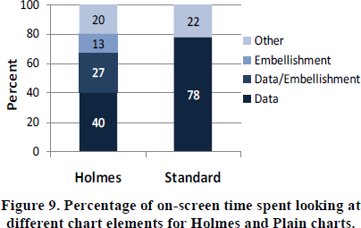
Chart junk and eye gaze
Notes:
Although 40% of users’ time was spent looking at embellishments for Holmes charts, this did not result in a longer time to describe the charts.

Slide 32
Returning to the Marks and Channels Activity
Go back to the visualization you chose for this activity
Work with 2 other people. Be prepared to share your work with the class.
Find a data visualization you think is interesting
Some ideas: New sites, government sites, Tableau, massvis.mit.edu
Write down what you chose on the board so we don’t get repeats!
Identify the following:
What is the data that’s being visualized?
Where did the data come from?
What marks and channels are used in the visualization?
What data dimensions do the marks and channels represent?
What do you learn from looking at the visualization?
What additional questions do you have?

Slide 33
Returning to the Marks and Channels Activity
Work with your group to answer:
Why did you choose this specific visualization?
Does the visualization follow all the design principles we just looked at?
If not, which are violated and how?
Do you think your answer to (2) impacted your answer to (1)?

Slide 34

Reminder
Our labs will be run using Tableau, a drag-and-drop visualization tool suite
Tableau for Teaching has donated license keys (good for one year) for everyone enrolled in this course
Instructions for getting a license have been posted; please install before next class!
Need help? Ping me, or come to office hours

